Slide 1
Digital Logic II. Combinational Circuits
Jalal Kawash

Slide 2
Outline
Digital Logic II
Combinational Circuits
Types of Circuits
Basic Combinational Circuits
Adders
Decodres
ALUs
More Combinational Circuits
Multiplexers
Multipliers
Comparators

Slide 3
Types of Digital Circuits
Digital Logic 2
Combinational Circuits
Section 1

Slide 4
Section 1 Objective At the end of this section you will
Digital Logic II
Combinational Circuits
Understand the difference between combinational and sequential circuits

Slide 5
Combinational Circuits
A combinational circuit is a logic circuit whose output is solely determined by the inputs
Combinational Circuit
n
inputs
m
outputs
…
…

Slide 6
Sequential Circuits
Unlike a combinational circuit, the output of a sequential circuit at time t can affect the circuits output at time t+1

Slide 7
Sequential Circuits
inputs
Combinational Circuit
outputs
Memory

Slide 8
Basic Circuits
Digital Logic II
Combinational Circuits
Section 2

Slide 9
Section 2 Objectives At the end of this section you will
Digital Logic II
Combinational Circuits
Be able to build half-adder (HA) circuits
Understand HA limitations
Be able to build full-adder (FA) circuits
Chain combinational circuits
Be able to build decoders
Understand how to use decoders as “switches” to build mult-function circuits

Slide 10
Half Adder (HA)
Input: two bits, x and y
Output: x + y
x | y | Sum | Carry
0 | 0 | 0 | 0
0 | 1 | 1 | 0
1 | 0 | 1 | 0
1 | 1 | 0 | 1

Slide 11
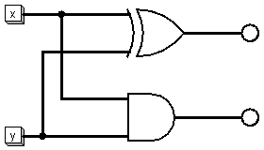
HA Circuit
x | y | Sum | Carry
0 | 0 | 0 | 0
0 | 1 | 1 | 0
1 | 0 | 1 | 0
1 | 1 | 0 | 1
Sum
Carry
Sum = x’y + y’x = x ⊕ y
Carry = xy
Source: DL2.circ (HA)

Slide 12
Limitation of a HA
Can we build an adder for 2-bit numbers from the 1-bit HAs?
x1
2-bit Adder
x+y
x
xo
y1
y
y0
carry

Slide 13
Limitation of a HA
Can we build an adder for 2-bit numbers from the 1-bit HAs? Does not work if x0 + y0 produce a carry!
1
x =
x1
x0
Can use a HA to produce
sum and possibly a carry
y =
y1
y0
+
Need an adder with 3 inputs
HA has only 2!
What if there is anon-zero carry?

Slide 14
Full Adder (FA)
Input: three bits, x, y, and z
Output: x + y + z
x | y | z | Sum | Carry
0 | 0 | 0 | 0 | 0
0 | 0 | 1 | 1 | 0
0 | 1 | 0 | 1 | 0
0 | 1 | 1 | 0 | 1
1 | 0 | 0 | 1 | 0
1 | 0 | 1 | 0 | 1
1 | 1 | 0 | 0 | 1
1 | 1 | 1 | 1 | 1

Slide 15
Full Adder – BSP for Carry
x | y | z | Sum | Carry
0 | 0 | 0 | 0 | 0
0 | 0 | 1 | 1 | 0
0 | 1 | 0 | 1 | 0
0 | 1 | 1 | 0 | 1
1 | 0 | 0 | 1 | 0
1 | 0 | 1 | 0 | 1
1 | 1 | 0 | 0 | 1
1 | 1 | 1 | 1 | 1
x’yz
xy’z
xyz’
xyz

Slide 16
Carry Function
Carry = x’yz + xy’z + xyz’ + xyz
Carry = x(y’z +yz’) + yz
Carry = x(y⊕z) + yz
m₀
m₁
m₃
m₂
m₄
m₅
m₇
m₆

Slide 17
Full Adder – BSP for Sum
x | y | z | Sum | Carry
0 | 0 | 0 | 0 | 0
0 | 0 | 1 | 1 | 0
0 | 1 | 0 | 1 | 0
0 | 1 | 1 | 0 | 1
1 | 0 | 0 | 1 | 0
1 | 0 | 1 | 0 | 1
1 | 1 | 0 | 0 | 1
1 | 1 | 1 | 1 | 1
x’y’z
x’yz’
xy’z’
xyz

Slide 18
Sum Function
Sum = x’y’z + x’yz’ + xy’z’ + xyz
Map is useless!!
m₀
m₁
m₃
m₂
m₄
m₅
m₇
m₆

Slide 19
Sum Function
Observation: (a ⊕ b)’ = a’b’ + ab
Proof:
(a ⊕ b)’ = (a’b + b’a)’ xor definition
(a ⊕ b)’ = (a’b)’(b’a)’ DeMorgan’s law
(a ⊕ b)’ = (a’’ + b’)(b’’ + a’) DeMorgna’s law
(a ⊕ b)’ = (a + b’)(b + a’) Double negation
(a ⊕ b)’ = ab + a’a + b’b + a’b’ Distribution
(a ⊕ b)’ = ab + a’b’ xx’ = 0, x+0=x

Slide 20
Sum Function
Sum = x’y’z + x’yz’ + xy’z’ + xyz
Sum = x’(y’z + yz’) + x(y’z’ + yz)
Sum = x’(y ⊕ z) + x(y ⊕ z)’
Sum = x ⊕ y ⊕ z
Let a = (y ⊕ z), Sum = x’a + xa’ = x ⊕ a

Slide 21
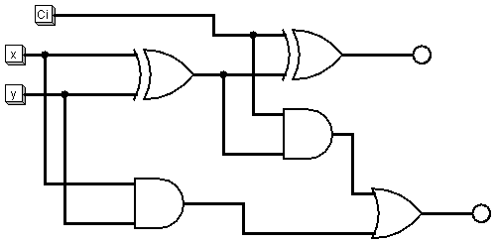
FA Circuit
Sum = x ⊕ y ⊕ z
Carry = x(y⊕z) + yz
Sum
Carry out
Source: DL2.circ (FA)

Slide 22
Chaining FAs (2-bit number FA)
x
FA
S
Add x₁x₀ to y₁y₀
y
z
C
x₀
FA
S₀
Result is C₁S₁S₀
y₀
0
C_{o}
x₁
FA
S1
y1
C1_{o}

Slide 23
4-bit Adder
x₀
FA
S₀
y₀
0
x₁
FA
S₁
y1
x₂
FA
S₂
y₃
x₃
S₃
FA
y₃
C1_{o}

Slide 24
Chaining
Chaining is an easy way to build “higher-order” circuits from “lower-order” ones
However, it is not the best
The longer the chain the slower the circuit
s₀
s₁
s₂
time

Slide 25
Full Subtractor
Can be built from a FA
x – y = x (y ⊕ 1) + 1
Why?

Slide 26
Decoders
A decoder is a combinational circuit such that
It has n inputs
It has 2^{n} outputs
For each input a unique associated output line carries 1
All other lines carry 0
Let b_{n} be the binary number corresponding to the input bits
If the input is b_{n}, then line b_{n} is set (carries 1)

Slide 27
2-4 Decoder
I₀
2-4 Decoder
F₀
0
2-4 Decoder
F₀
I₁
F₁
0
F₁
F₂
F₂
F₃
F₃

Slide 28
2-4 Decoder
0
2-4 Decoder
F₀
1
2-4 Decoder
F₀
1
F₁
0
F₁
F₂
F₂
F₃
F₃

Slide 29
2-4 Decoder
1
2-4 Decoder
F₀
1
F₁
F₂
F₃

Slide 30
Multi-Function Circuits
Hardware runs all the time
A multi-function circuit will compute all of its functions
A decoder is used to “filter out” the functions that are not required

Slide 31
4-Function Circuit
I₀
2-4 Decoder
F₀
I₁
F₀
F₁
Selected
Function
F₁
F₂
F₂
F₃
F₃
Data
input

Slide 32
2-4 Decoder (Truth Table)
x | y | F₀ | F₁ | F₂ | F₃
0 | 0 | 1 | 0 | 0 | 0
0 | 1 | 0 | 1 | 0 | 0
1 | 0 | 0 | 0 | 1 | 0
1 | 1 | 0 | 0 | 0 | 1

Slide 33
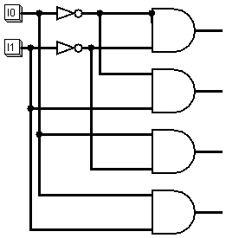
2-4 Decoder (Circuit)
Source: DL2 (2-4 Decoder)

Slide 34
3-8 Decoder
Exercise

Slide 35
A Simple ALU
Digital Logic II
Combinational Circuits
Section 3

Slide 36
Section 3 Objectives At the end of this section you will
Digital Logic II
Combinational Circuits
Build a simple 1-bit ALU
Use chaining to build higher order ALU

Slide 37
Bit Slice
A bit slice is a 1-bit ALU
We will use chaining to create a larger ALU
ALU can do
And
Or
Not
Addition
Only

Slide 38
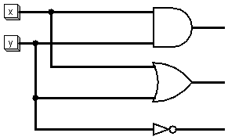
Logic Unit
xy
x+y
y’
Source: DL2 (Logic Unit)

Slide 39
x
Bit slice
y
xy
Logic Unit
Decoder
x+y
I₀
I₁
Carry
in
y’
Full Adder
Sum(x,y)
Carry
OR
Carry out
Output ∈ {xy, x+y, y’ , Sum(x,y)}

Slide 40
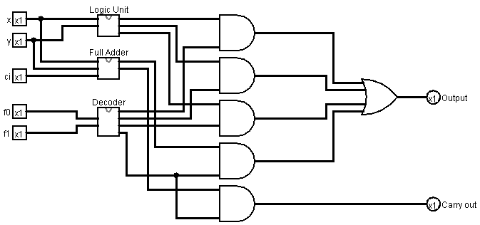
Bit slice demo
Source: DL2.circ (Bit Slice)

Slide 41
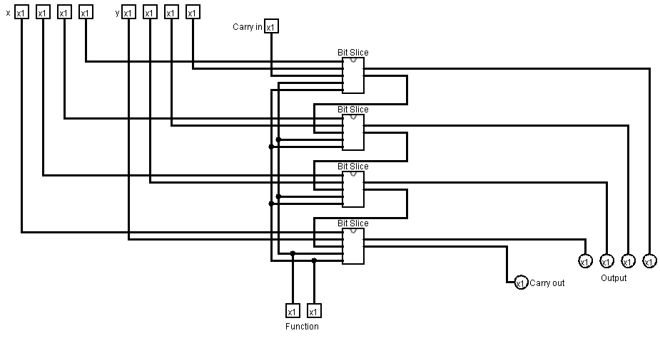
4-bit ALU (by chaining)
Source: DL2 (4-bit ALUS)

Slide 42
More Combinational Circuits
Digital Logic II
Combinational Circuits
Section 4

Slide 43
Section 4 Objective At the end of this section you will
Digital Logic II
Combinational Circuits
Gain more practice with combinational circuits

Slide 44
Multiplexers
S
I₀
X ∈ {I₀, I₁}
I₁
Multiplexer
If S = 0, X = I₀
If S = 1, X = I₁

Slide 45
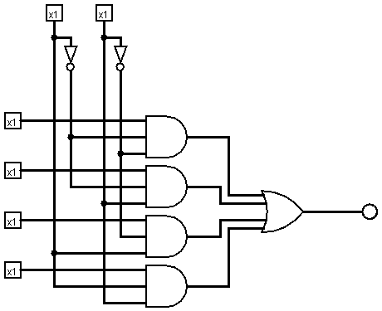
4-Input Multiplexer
S1
S0
I0
I1
I2
I3
Source: D2l.circ (4-input Multiplexer)

Slide 46
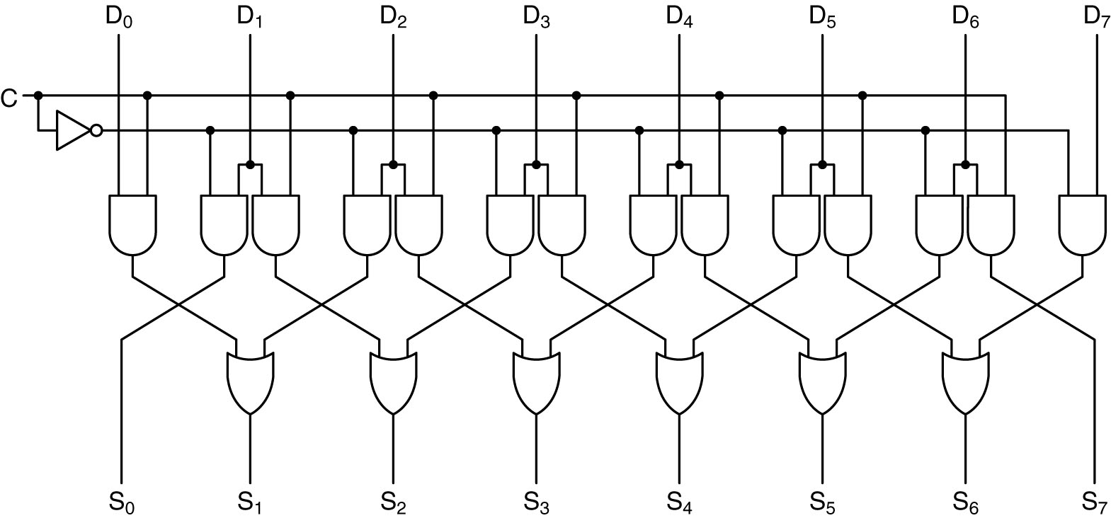
Shifters
A 1-bit left/right shifter.
C = 0 for left 1 for right
1-bit left/right shifter.
C = 0 for left 1 for right

Slide 47
Left Shift
C = 0
D₀D₁D₂D₃D₄D₅D₆D₇
D₁D₂D₃D₄D₅D₆D₇ 0
D1
D2
D3
D4
D5
D6
D7
0
0
0
0
0
0
0
D1
D2
D3
D4
D5
D6
D7
0

Slide 48
Right Shift
C = 1
D₀D₁D₂D₃D₄D₅D₆D₇
0 D₀D₁D₂D₃D₄D₅D₆
D0
D1
D2
D3
D4
D5
D6
0
0
0
0
0
0
0
0
D0
D1
D2
D3
D4
D5
D6
From Tanenbaum, Structured Computer Organization, Fifth Edition, (c) 2006 Pearson Education, Inc. All rights reserved.

Slide 49
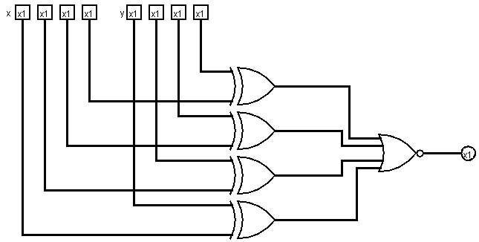
Comparators
Two bits can be compared with a XOR gate
Two numbers can be compared bit-wise

Slide 50
Magnitude Comparator
Challenge yourself with designing a circuit that inputs 2-bit binary numbers A & B
It has 3 outputs:
First output is 1, iff the numbers are equal
Second is 1, iff A < B
Third is 1, iff A > B
Repeat for 4 bit numbers

Slide 51
Multipliers
Multiplication can be done by addition
To multiply X and Y, add Y to itself X times; or add X to itself Y times
Challenge yourself to build a “direct” multiplier
i.e., do not use the method described above
Hint: fix the size of your inputs; e.g., multiply 2-bit by a 3-bit number

Slide 52
Self-Test Quiz
Challenge yourself to build a “direct” multiplier that multiplies 2-bit by a 3-bit number

